Slide 1

Global Allied Pharmaceuticals, LLC.
Innovation, Research, and Technology in
Biopharmaceuticals.
www.takechargemedical.com www.Nexusalliancebiopharma.com

Slide 2
Overview of NAB
Nexus Alliance Biopharma is an early stage R&D company in biopharmaceutical, with offices in FL, LA, and NJ for the past 15 years, dedicated to repurposing and reformulation. Owner and collaborator of the Specific Conjugate Particles (SCP) technology. We offer cost effective and efficient model of drug delivery for targeted indications.
www.takechargemedical.com www.Nexusalliancebiopharma.com

Slide 3
Vision
We envision a line of products which will be used for the treatment for Coronavirus
Why would anyone invest in?
We donate our IP for COVID- 19 indications.
We are asking for Joint Venture development and distribution of the advanced formulation of the otherwise water-insoluble drugs of choice of hydroxychloroquine, chloroquine, and antiviral agents to produce an advanced Benefit:Risk ratio.
www.takechargemedical.com www.Nexusalliancebiopharma.com

Slide 4
Our Approach
Safe
Strong safety profile (history, MOA, Route of Delivery, supporting data)
Platform with relevant and many potential applications in areas of founders’ expertise as well as where clear differentiation leads to value
Credible Scientific Hypothesis
Solid science supported by human and animal data- We have solid human & Pre- clinical data at this point as a proven track record of a proof of concept.
www.takechargemedical.com www.Nexusalliancebiopharma.com

Slide 5
Our Platform- SCP Technology
A novel platform
Two different and independently acting compounds are combined into one hybrid compound that can synergize
Potency of the new composite compound is greater than the sum of each individual moiety.
Precedent for hybrid compounds comes from naturally occurring proteins and small molecules.
Compound A
Compound B
Hybrid SCP Compound
www.takechargemedical.com www.Nexusalliancebiopharma.com

Slide 6
SCP: A NAB’s first generation product Platform
5 fold reduction in the production cost against liposome technology.
SCP- X improves the risk: benefit ratio of the predicated known generics by over 10 folds.
Nexus has a healthy pipeline in a well diversified field of development and delivery.
We are capable to expand the ADC technology into the existing pipelines. It would complement the existing trials into an expanded franchise utilizing ADC technology and beyond.
Joint Development Services: It may expand your potential vaccines, antibodies, as well as combinations into a more robust franchise.
*Production Cost of SCP- X, where X is the drug substance (known moieties) as opposed to the predicated X is no more than 40%.
** Currently, GAP is working on the production of vitamin D3 along with 5 additional products in oncology with the upshot of close to $1.5B value post their phase II.
www.takechargemedical.com www.Nexusalliancebiopharma.com

Slide 7
SCP technology
The Ultimate Solubility and Bioavailability Dream
Well diversified IP from Unmet medical needs into supplements.
Proven track record of benchmark, first in human, as well as projections into OTC and supplements.
Manufacturing advantage of no more than 35% improvement in cost to scale up into large volume production.
A healthy pipeline of products, diversified across therapeutic areas, expansion into repurposing of products into multiple life cycle indications.
Increase the dose by 10- 30X, reduce the TEAEs by multiple folds in severity and frequency of the events. Give the products for a longer duration and expect many folds of efficacy over time.
www.takechargemedical.com www.Nexusalliancebiopharma.com

Slide 8
IP SCP assets
IP ownership of 114 assets
Targeted TAs include oncology, Neurology and unmet medical needs of right to thrive populations.
Early validation
34/115 assets have shown benchmark and in-vivo/in-vitro positive results
Proof-of-concept
First in Human
24/34 products have shown preliminary positive results in early clinical trials
Potential superiority over the current Standard of care
24/34 products have demonstrated potentially superior data vs standard of care with 5-10x increase of benefit/risk ratio through increased bioavailability, activity and safety profile.
www.takechargemedical.com www.Nexusalliancebiopharma.com

Slide 9
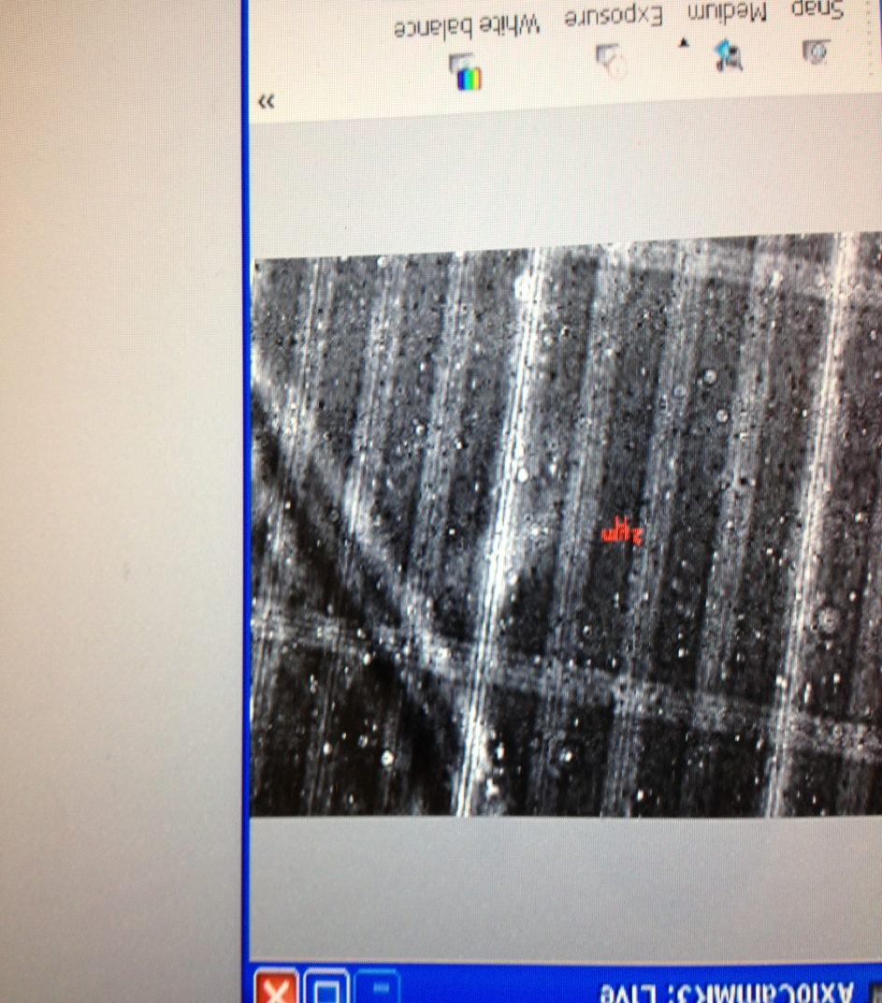
Particle size
Physiochemical Properties for SCP formulations
Between 180 to 190 nm
Size distribution
10 nm to 190 nm
www.takechargemedical.com www.Nexusalliancebiopharma.com

Slide 10
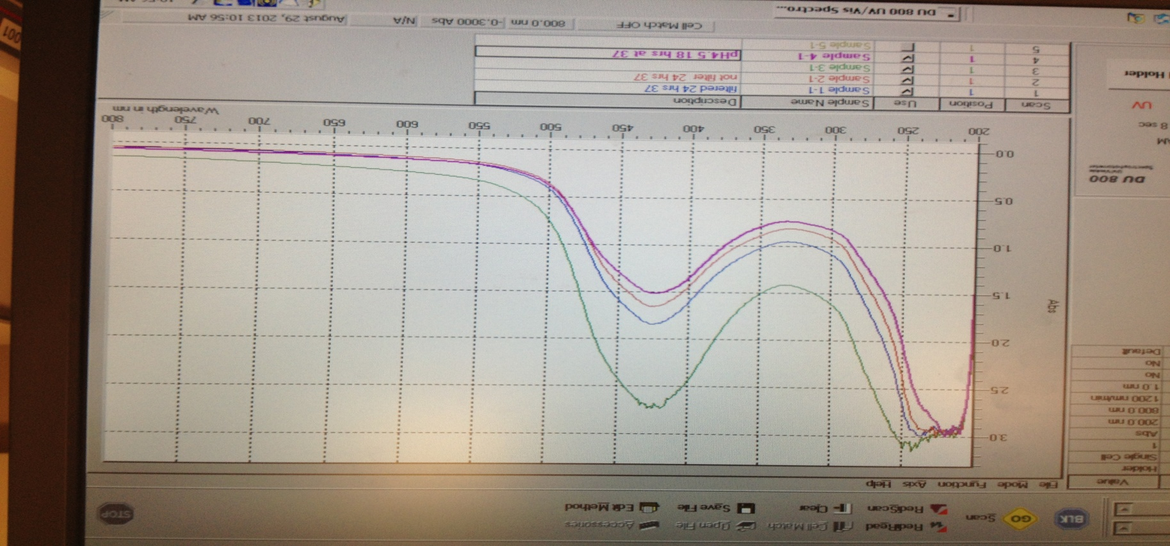
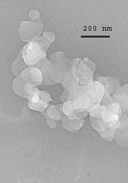
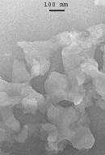
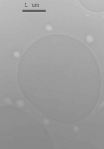
Dissolution dissolved in 5 minutes
Particle stability
Stable at 3.5 and 7.2 pH
Time
5 minutes
www.takechargemedical.com www.Nexusalliancebiopharma.com

Slide 11
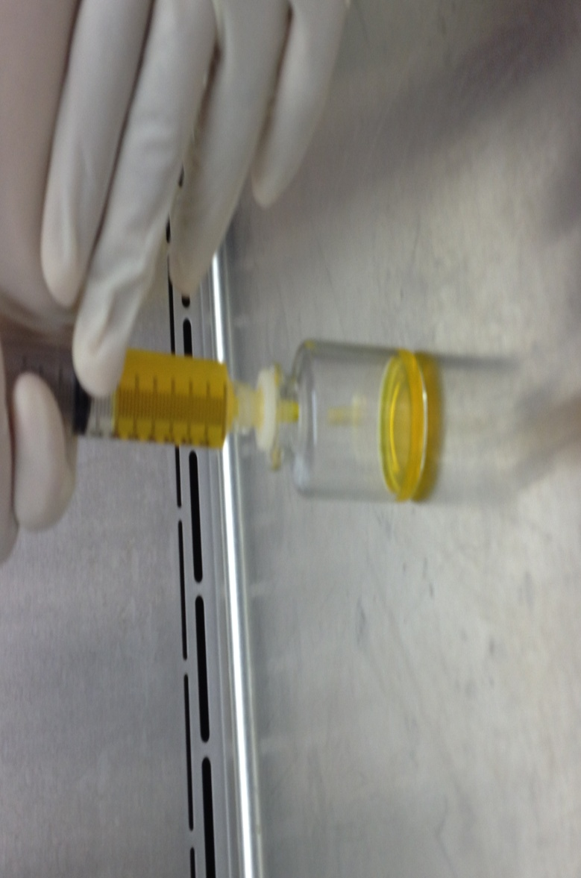
Terminal Sterilization
Sterile filtration
1.There is no loss of drug at final step of sterile filtration step.
2. A pilot scale preparation of five liters has been evaluated
for validation.
www.takechargemedical.com www.Nexusalliancebiopharma.com

Slide 12
Science
Research History – (History of company) – milestones (patents awarded, etc.)
Key studies milestones
www.takechargemedical.com www.Nexusalliancebiopharma.com

Slide 13
Coronavirus- Background
COVID-19 is caused by a coronavirus
Rarely, animal coronaviruses can infect people and then spread between people such as with MERS-CoV, SARS-CoV, and now with this new virus (named SARS-CoV-2).
The complete clinical picture with regard to COVID-19 is not fully known.
Older people and people of all ages with severe chronic medical conditions — like heart disease, lung disease and diabetes, for example — seem to be at higher risk of developing serious COVID-19 illness
www.takechargemedical.com www.Nexusalliancebiopharma.com

Slide 14
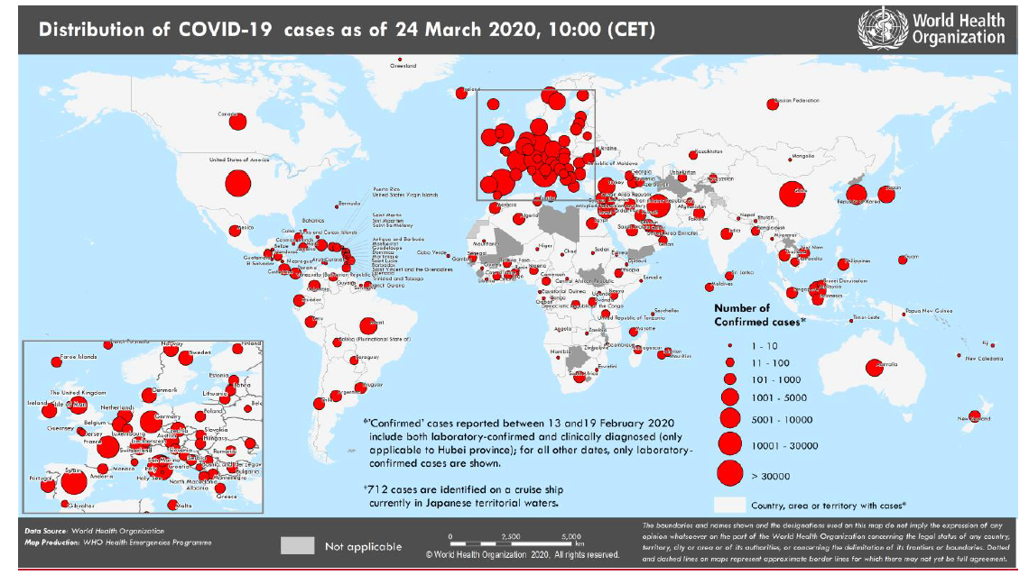
www.takechargemedical.com www.Nexusalliancebiopharma.com

Slide 15
Clinical Studies
World Health Organization (WHO) announced a large global trial, called SOLIDARITY, to find out whether any can treat infections with the new corona virus.
Drugs under trial
Remdesivir
Choloroquine/Hydroxychloroquirine
Ritonavir/lopinavir
Beta Interferon
www.takechargemedical.com www.Nexusalliancebiopharma.com

Slide 16
COVID-19- Current available treatments
Anti-virals like ribavirin, penciclovir, nitazoxanide, nafamostat, chloroquine
Broad-spectrum antiviral drugs remdesivir (GS-5734) and favipiravir (T-705) against a clinical isolate of 2019-nCoV in vitro
Global Allied Pharmaceuticals www.gapsos.com

Slide 17
Role of Chloroquine
An anti-malarial and autoimmune disease drug (broad-spectrum antiviral drug).
MOA: Block virus infection by increasing endosomal pH required for virus/cell fusion, as well as interfering with the glycosylation of cellular receptors of SARS-CoV.
Also has immune-modulating activity, which may synergistically enhance its antiviral effect in vivo.
Global Allied Pharmaceuticals www.gapsos.com

Slide 18
Therapies for confirmed COVID-19 in some European countries
Disease category | Italy | France | Netherlands | Switzerland
Mild-to-moderate disease No risk group | No antiviral treatment | No antiviral treatment | No antiviral treatment | No antiviral treatment
Mild-to-moderate disease No risk group | lopinavir/ritonavir + chloroquine or hydroxychloroquine for 5-7 days | Consider lopinavir/ritonavir; duration depending on monitoring of viral excretion | Consider chloroquine for 5 days | ? (not mentioned)
Severe disease | remdesivir + chloroquine or hydroxychloroquine for 5-20 days (if no remdesivir: maintain lopinavir/ritonavir with chloroquine) | remdesivir; duration depending on monitoring of viral excretion (No second choice) | chloroquine D1 (600-300 mg; D2-D5 300 mg BID) lopinavir/ritona vir as second option (for 10- 14 days) | Lopinavir/ritonavir (atazanavir/ritonavir as second choice)
Critical disease | remdesivir + chloroquine or hydroxychloroquine for 5-20 days (if no remdesivir: maintain lopinavir/ritonavir with chloroquine) | remdesivir; duration depending on monitoring of viral excretion. Lopinavir/ritona vir as second choice (case by case) | remdesivir (for 10 days) + chloroquine (for 5 days) | remdesivir as first choice (for 10 days). lopinavir/ritonavir (+ hydroxychloroquine if < 65 years/no comorbidity) as second choice (if remdesivir unavailable). Tocilizumab (in case of MOF and inotropic support)

Slide 19
Novel virus?
Needs novel Treatment..
IP protected SCP technology
A game changer in making
www.takechargemedical.com www.Nexusalliancebiopharma.com

Slide 20
Our proposal: SCP + remdesivir, SCP + Chloroquine & Combination therapy (SCP + remdesivir+ Chloroquine)
5 fold reduction in the production cost against liposome technology.
Rapid onset of action and decrease duration of hospitalization.
SCP-X improves the risk: benefit ratio of the predicated known generics by over 10 folds.
Reduce the TEAEs by multiple folds in severity and frequency of the events.
Single drug (May be a wonder drug)
The excipients are known and innocuous entities. The technology is IP protected with a proven track record. Excipients assure hydrolysis are known entities and no toxicological measures are necessary.
Currently, 38 patients are showing anecdotal responses.
www.takechargemedical.com www.Nexusalliancebiopharma.com

Slide 21
What we ASK from Sponsors?
$5m for the line of combo treatment + SCP
1M for investigator initiated trails
$2.5M for the expanded trial post investigator initiated trials IITs in Italy, S. Korea and the US
Rest shall be used for post 505 b(2) approval.
Timelines: 1-6 months for initiation till finalization.
Post covid-19, SCP- antiviral is a more than $300M/ur ROI worldwide.
www.takechargemedical.com www.Nexusalliancebiopharma.com

Slide 22
Development Costs and Timeline
Stage of Development | Time Line | SCP-Antivirals (cost)
Facility and Operational Costs, Drug Discovery, Proof-of-concept, Pharmacokinetics, Documents, Medicine & Tox Study, Preclinical Studies | On Going & Finished | $ 1 Million
Pre IND (505 b2 process) | On Going & Finished | $ 0.5 Million
Phase I Trials | 2 months | $ 1 Million
Phase II Trials | 2 months | $ 2 Million
Phase III Trials | 3 Months | $ 3 Million
NDA Application | 1-2 Months | $ 1 Million
Misc Operational Expenses | On Going | $ 0.5 Million
Total | 9 months | $ 9 Million

Slide 23
The Winning Team
Timothy Allen, M.D., Ph.D: Chief Medical Scientist and Advisor to the Board at Global Allied Pharmaceuticals. A professional in early/late-stage development/launching, regulatory, safety, clinical development, and joint venture/due diligence collaboration in biopharmaceuticals. authored published 68 papers and three textbooks. An ex- fellow at FDA and CIOMS. A current CIOMS contributor. A US-trained MD in internal medicine and hem. Oncology with sub- fellowship in Immune Oncology. Ph.D. in Epidemiology- biostatistics analysis. Proficient in IND, NDA, BLA, and Early Development into Launching.
Nepton Sheikh- Khoni MD: CEO of Nexus Alliance Biopharma. A Clinical/Medical Practitioner for more than 14 years and 9 years in Clinical development. A medical doctor with adequate clinical training in internal medicine and oncology.
Ghazaleh Shoja E Razavi MD: Ghazaleh is a practicing hematologist, medical oncologist with more than ten years of clinical and 5 years of industry experience. She has also trained in supportive and palliative care in Italy, granted by European Society for Medical Oncology (ESMO) in 2007 and completed her clinical fellowship in malignant hematology and stem cell transplant in Canada in 2017.
www.takechargemedical.com www.Nexusalliancebiopharma.com

Slide 24
References and Published papers
Wang, M., Cao, R., Zhang, L. et al. Remdesivir and chloroquine effectively inhibit the recently emerged novel coronavirus (2019-nCoV) in vitro. Cell Res 30, 269–271 (2020). https://doi.org/10.1038/s41422-020-0282-0
Published papers on the SCP technology can be found at below links:
http://www.nexusalliancebiopharma.com/articles.php
http://www.nexusalliancebiopharma.com/product/books.php
Contact us: Timothy Allen, MD, PhD Email ID: timothy.Allen@TakeChargeMedical.com Cell phone: 321-945-4283
www.takechargemedical.com www.Nexusalliancebiopharma.com

